Slide 1
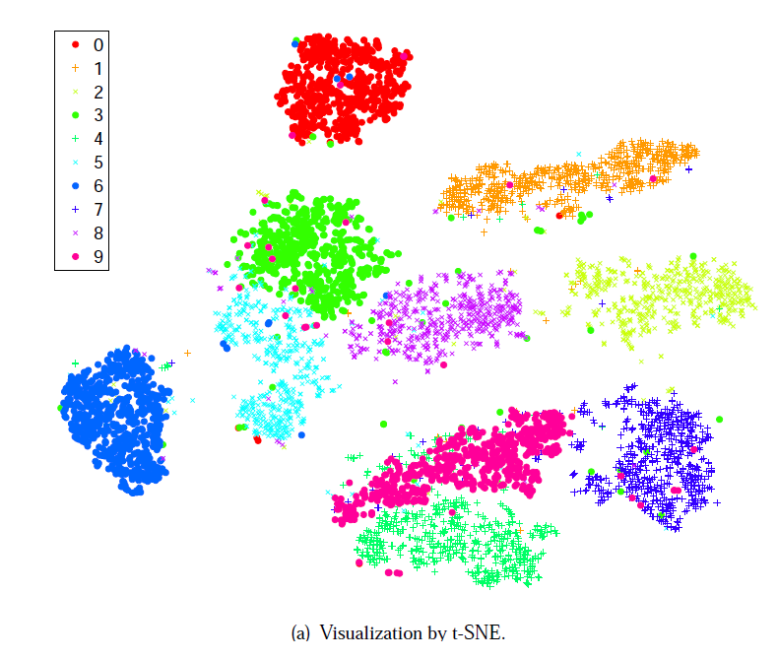
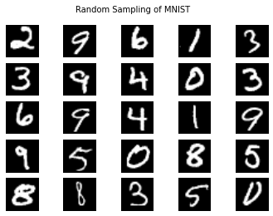
Visualizing Data using t-SNE

Slide 2
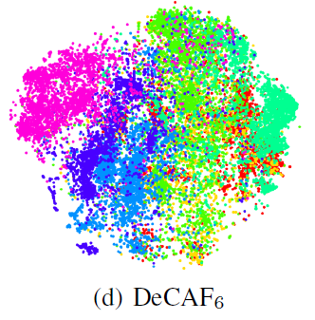
Problem:
How can humans visualize high-dimensional data?
images (pixels can be considered dimensions)
single cell nuclei is described by 30 variables (variables = dimensions)
Specifically ...
How to visualize in 2D or 3D space?
to see relationships
check if features are separating the data

Slide 3
Original high-dimensional (high-d) space
Desired low-dimensional (low-d) space

Slide 4
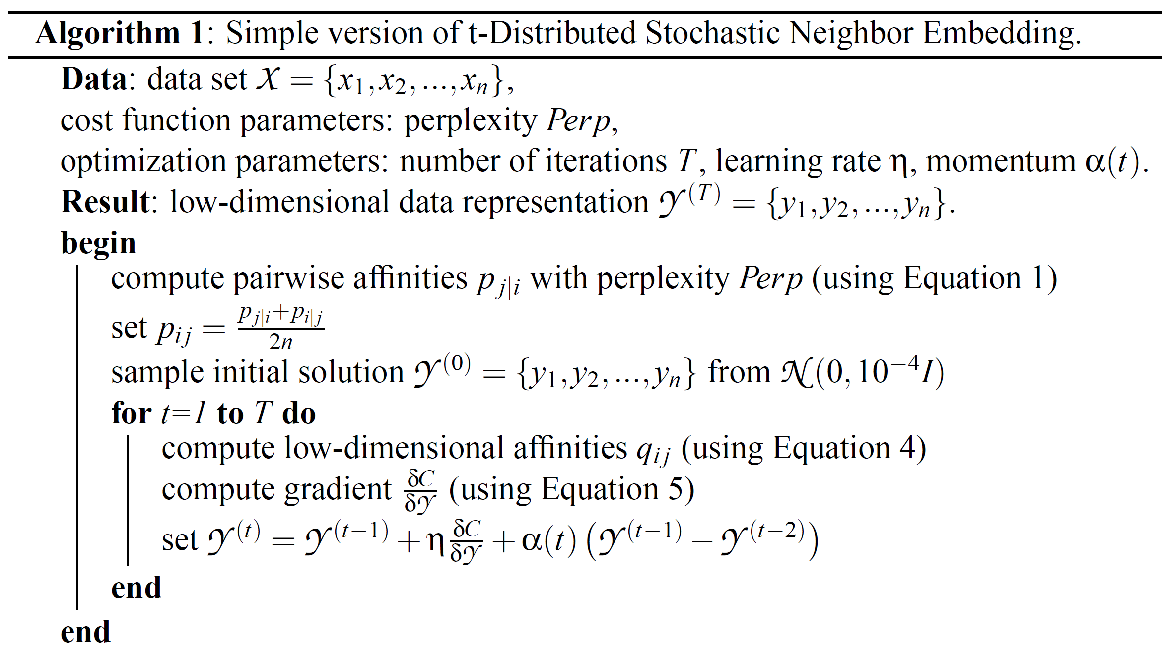
Outline of chat:
Briefly compare results of different visualization methods
(convince you this method is interesting)
Discuss the details of this algorithm
How high-d data is modeled
How low-d data is modeled
What we optimize
How we optimize
A few passes:
high level, low level, practical details

Slide 5
Why this approach?
Many other ways to visualize High-D data…
Sammon mapping
Isomap
Local Linear Embedding
PCA
many more...
Why study t-SNE?

Slide 6
Why learn about t-SNE?
Claim: better visualizations than other methods
Prize winning! molecular visualization challenge
http://blog.kaggle.com/2012/11/02/t-distributed-stochastic-neighbor-embedding-wins-merck-viz-challenge/
Code available: integrated into Python
Common approach: ~800 citations

Slide 7
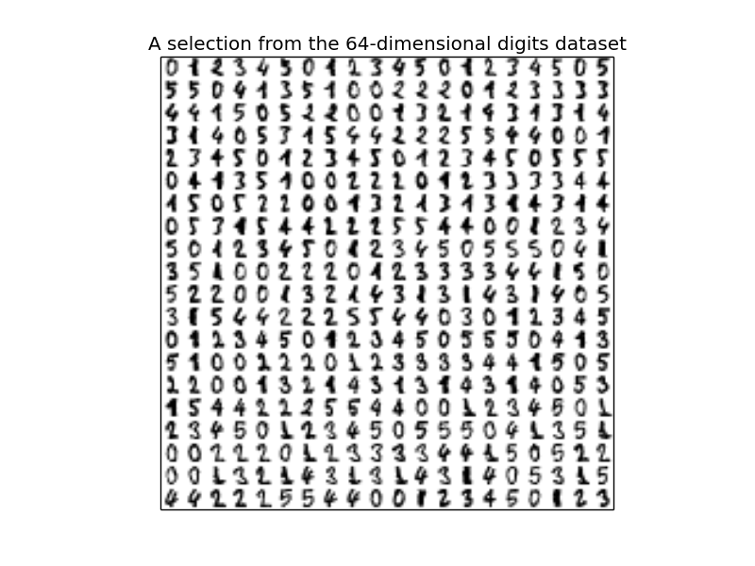
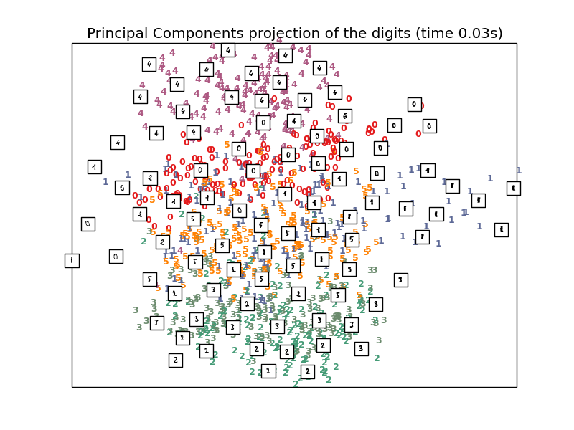
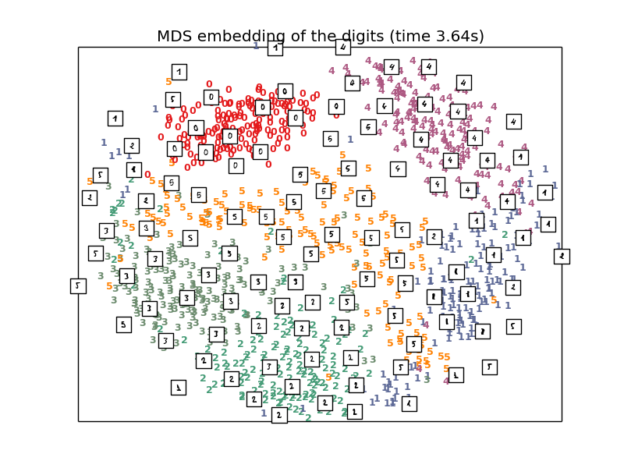
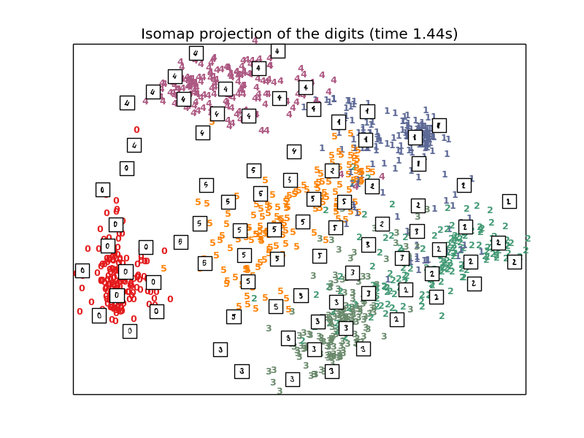
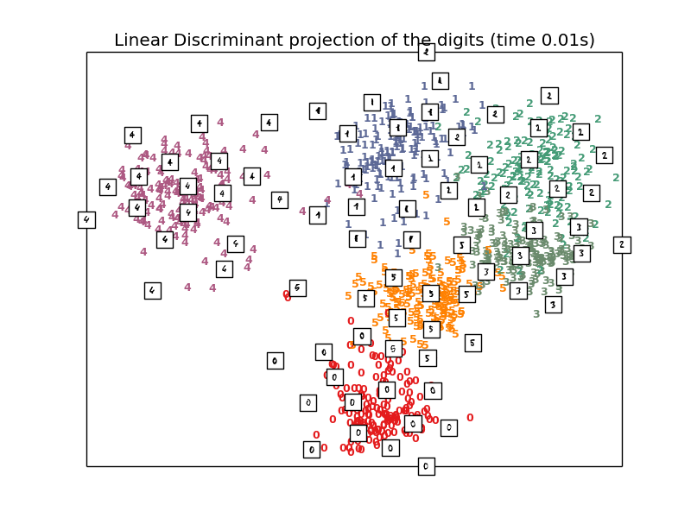
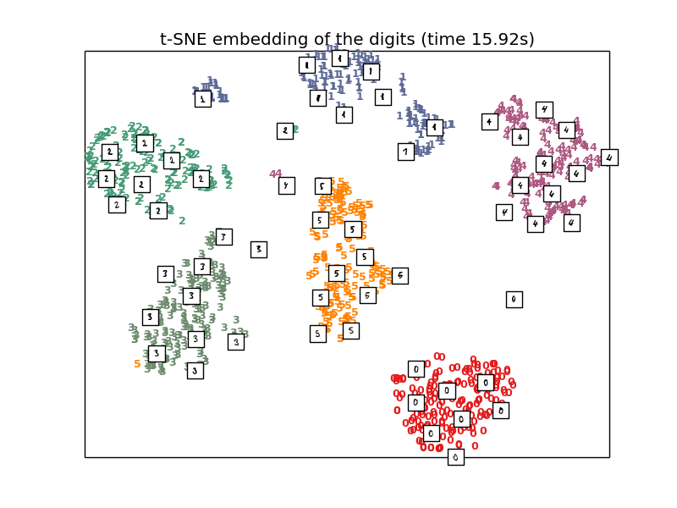
http://scikit-learn.org/stable/auto_examples/manifold/plot_lle_digits.html

Slide 8
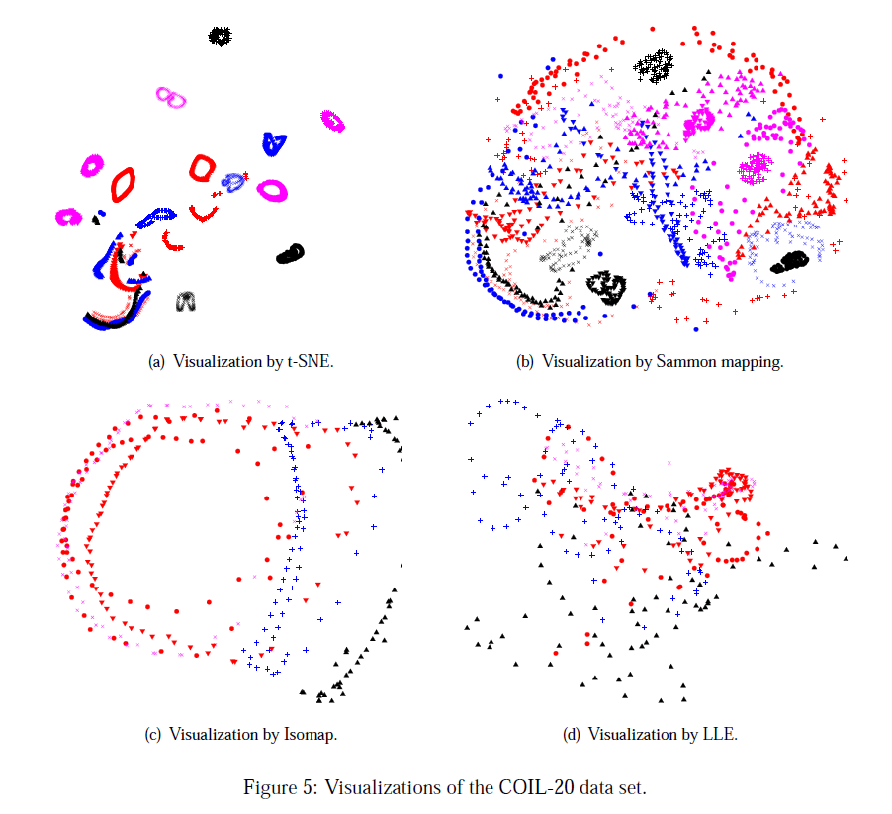
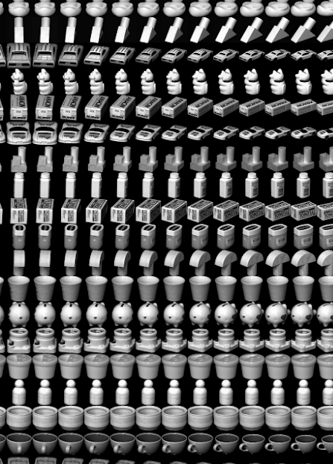

Slide 9
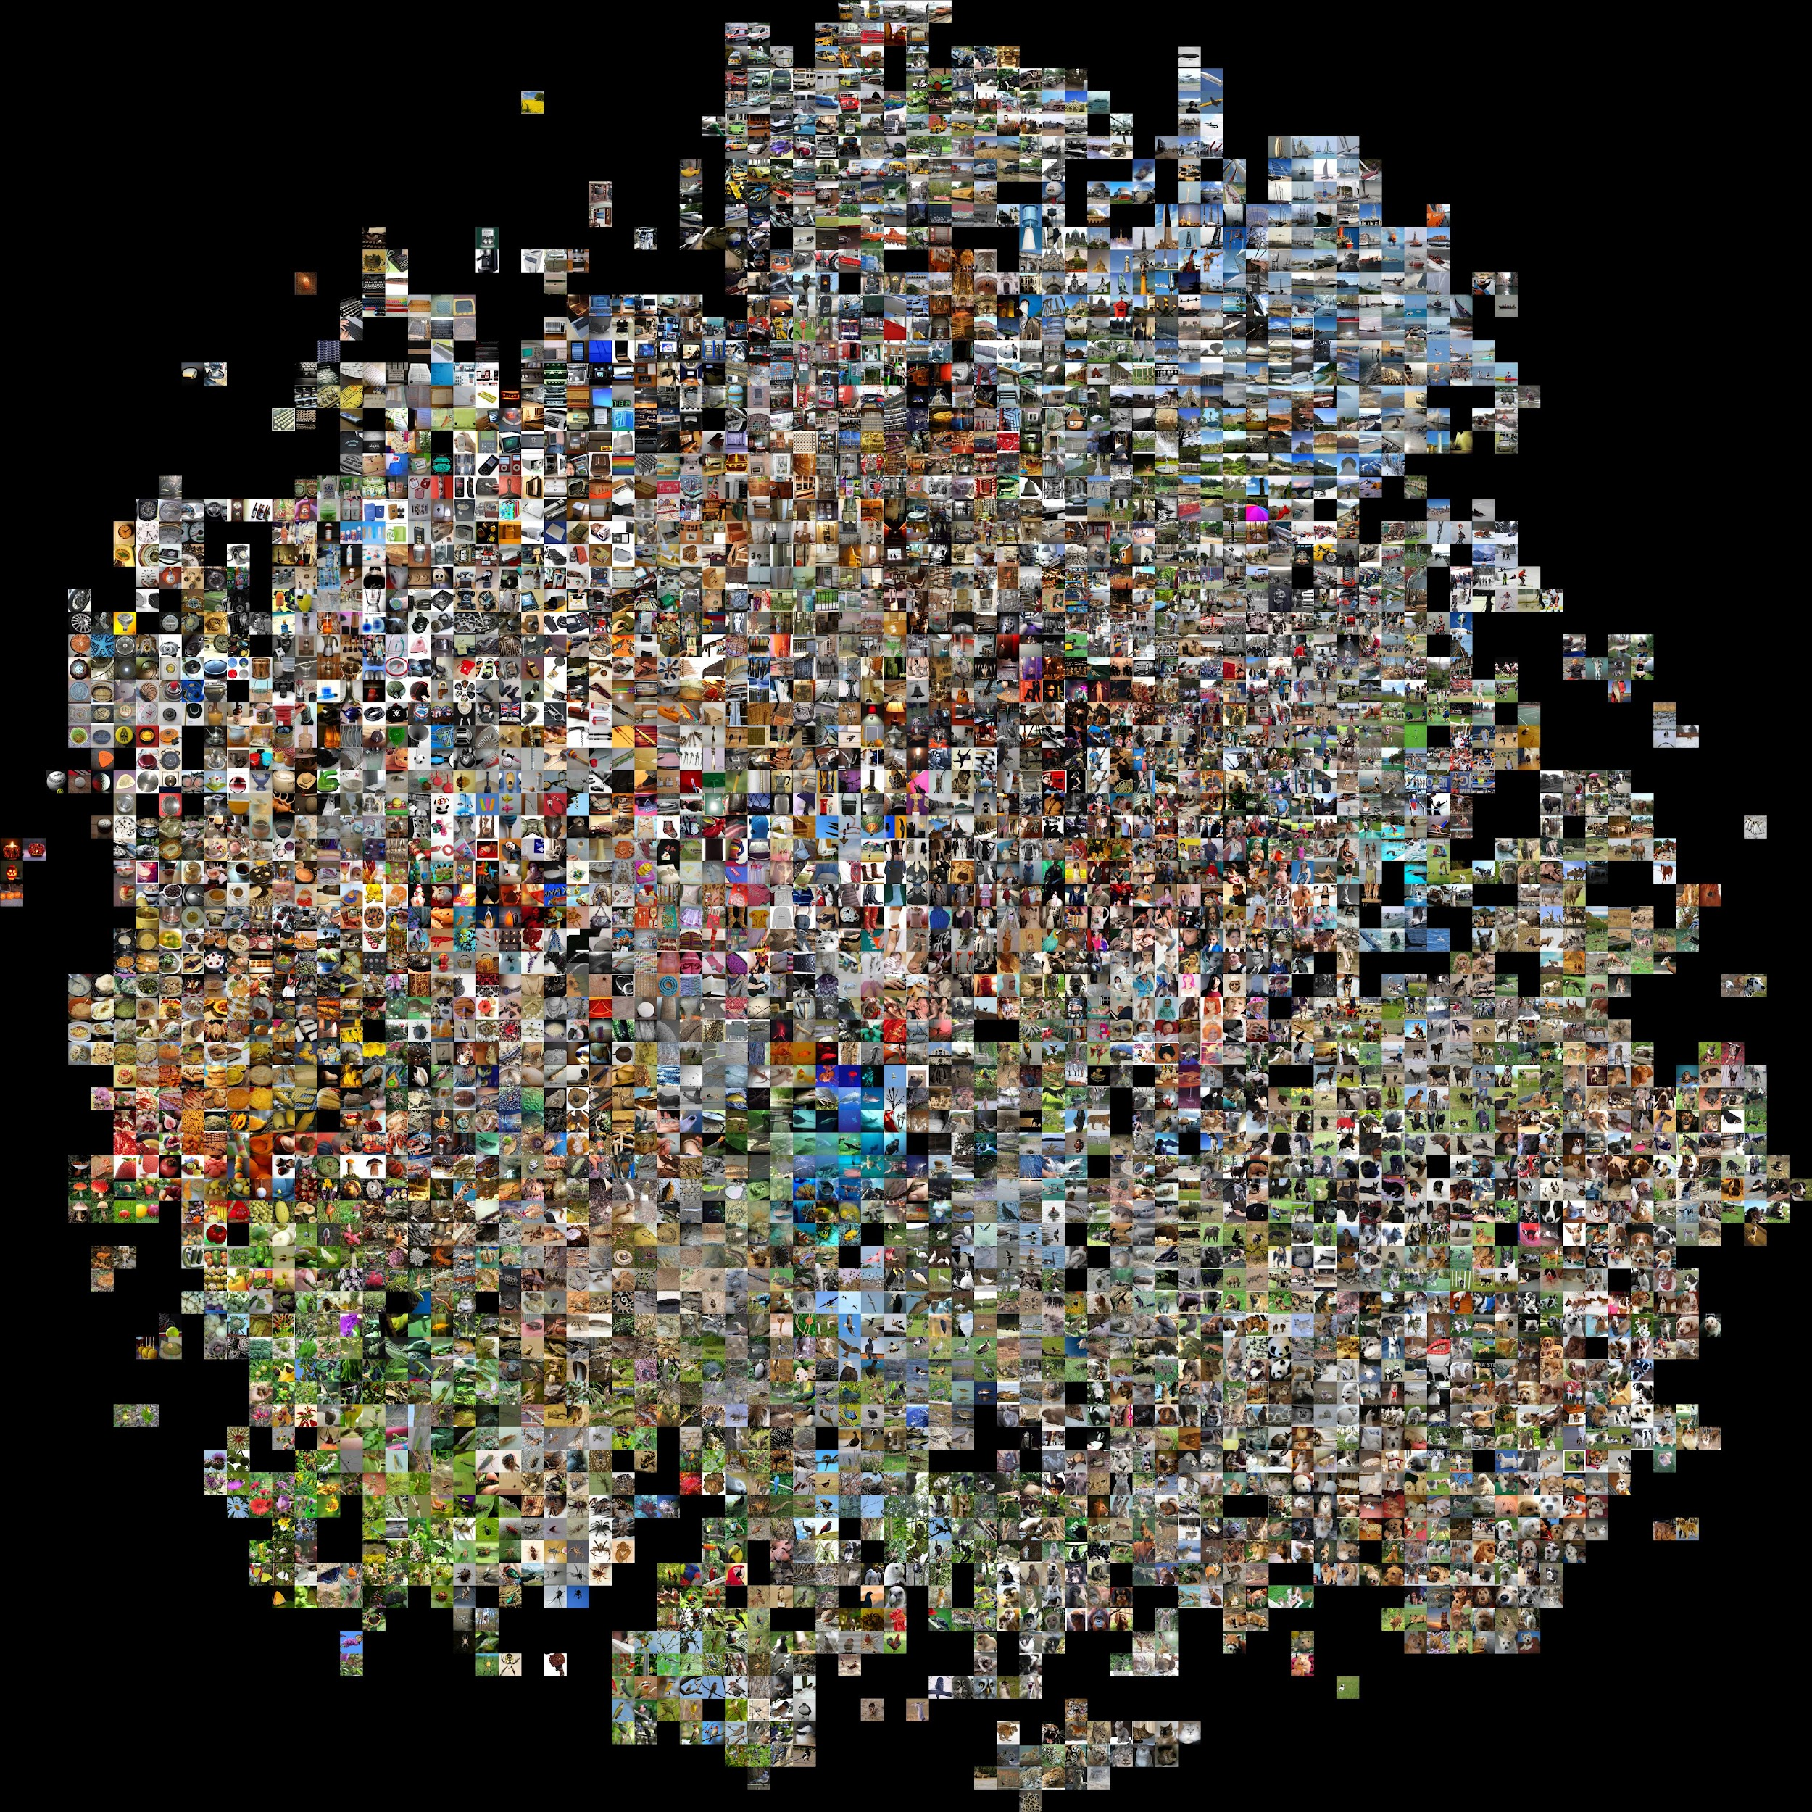
ImageNet
http://cs.stanford.edu/people/karpathy/cnnembed/cnn_embed_4k.jpg

Slide 10
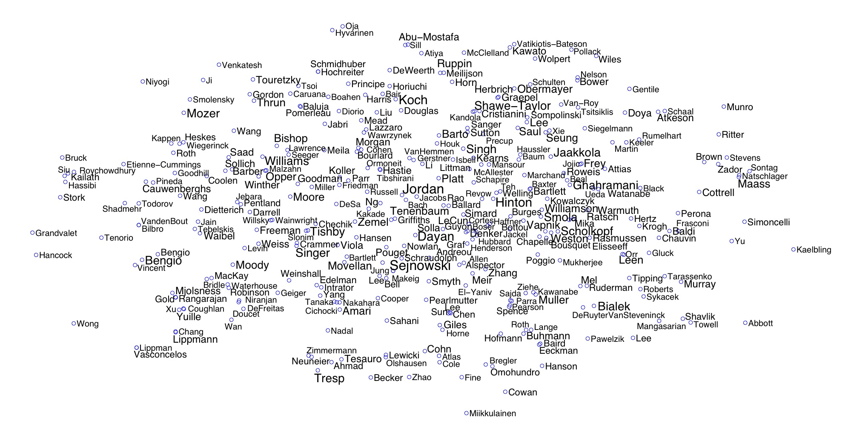
NIPS coauthorship
http://lvdmaaten.github.io/tsne/examples/nips_tsne.jpg

Slide 11
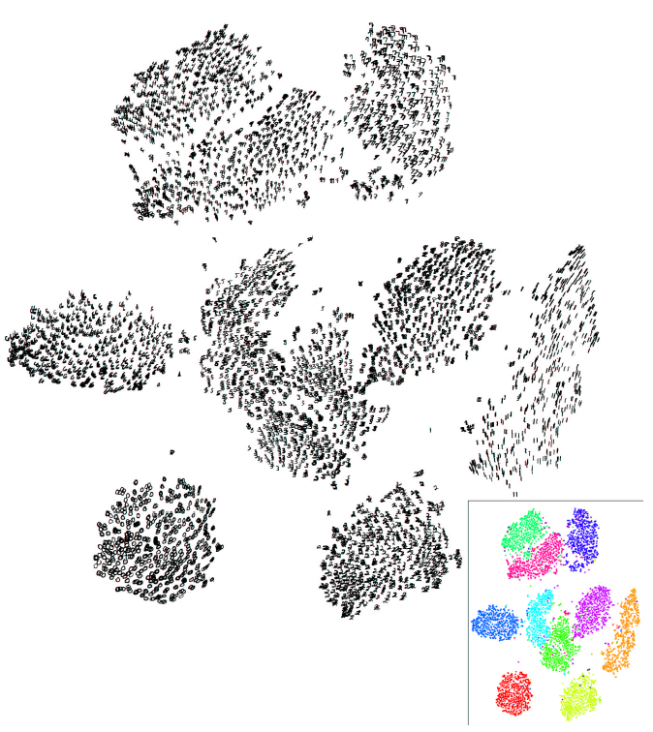
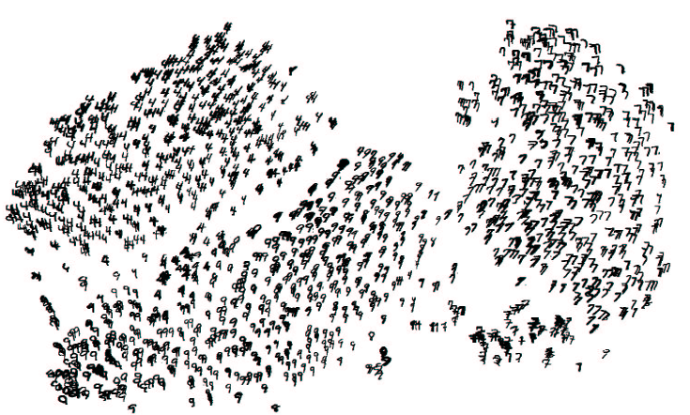

Slide 12
What is t-SNE?
t-Distributed Stochastic Neighbor Embedding (t-SNE)
Unsupervised (does not use class labels)
Models the probabilities that high-d points xi,xj are neighbors
Models the probabilities the corresponding low-d
points yi,yj are neighbors
Finds a low-d representation that is faithful to the high-d model

Slide 13
The basic algorithm …

Slide 14
Start at a high level
(we will do a few passes through this algorithm)

Slide 17
Compute probabilities P that xi
and xj are neighbors
(based on Euclidian distance in high-d space)

Slide 18
Compute probabilities Q that yi and yj are neighbors (corresponding to xi, xj)
(based on Euclidian distance in low-d space)

Slide 19
Key assumption is that the high-d P and the low-d Q probability distributions should be the same

Slide 20
Find a low-d map that minimizes the difference between the P (high-d) and Q (low-d) distributions
(if xi,xj has high probability of being neighbors in high-d, then yi,yj should have high probability in low-d)

Slide 21
We will minimize the difference between the high-d and low-d maps using gradient descent

Slide 22
Now for the details …
(Pass 2)

Slide 23
User specifies a perplexity value
(a number usually between 5 and 50)
(discuss this more later… )

Slide 24
Set optimization parameters for gradient descent

Slide 25
Gradient descent is iterative. Specify a max number of iteration
(experiments used 1000)

Slide 26
Gradient descent steps in the direction
that minimizes the error.
The learning rate is how big of step to take.
All experiments used the same values

Slide 27
Momentum term encourages a step that is in the same direction as previous steps
All experiments used the same values

Slide 28
This is our low-d solution
(represents the corresponding high-d data)
This is what we want to find/optimize for!

Slide 29
Input
Output
User parameters, set the same for the experiments

Slide 30
The meat of the presentation

Slide 31
In the high-d space

Slide 32
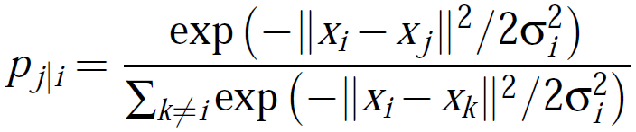
The probability that xi would choose xj as its neighbor

Slide 33
Two data points in the high-d space

Slide 34
Compute the Euclidean distance between the two points

Slide 35
xi chooses xj as its neighbor based on a Gaussian centered at xi
Variance for each xi (discuss soon)

Slide 36
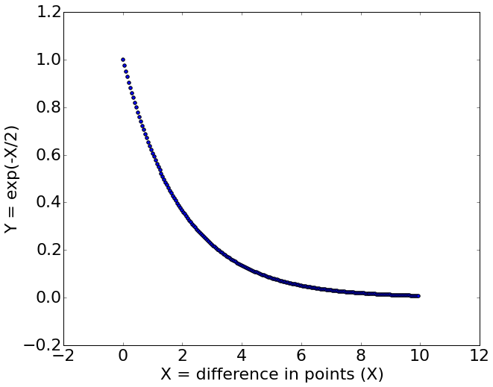
xi chooses xj as its neighbor based on a Gaussian centered at xi
xi's that are "close" (low Euclidean distance) return a high value
xi's that are "far" (high Euclidean distance) return a low value

Slide 37
Sum over all the other high-d points
(normalizes to make a probability)
xi's that are "close" (low Euclidean distance) return a high value
xi's that are "far" (high Euclidean distance) return a low value

Slide 38
What about the variance?

Slide 39
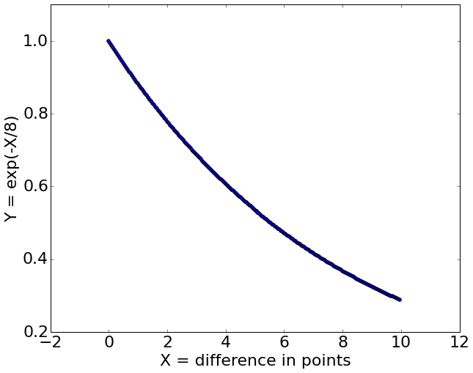
What about the variance?
Changing the variance will change the values we assign to the distances

Slide 40
What about the variance?
A single variance is not likely optimal since the density of the data will vary
In dense regions, we probably want a smaller variance
In sparse regions, we probably want a larger variance

Slide 41
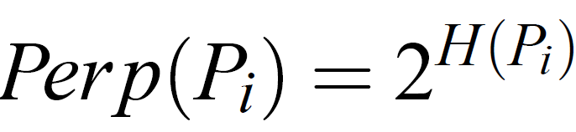
Given a variance, we can compute the probability distribution Pi for all other data points for xi

Slide 42
Given a variance, we can compute the probability distribution Pi for all other data points for xi
We can compute perplexity for a probability distribution given a variance

Slide 43
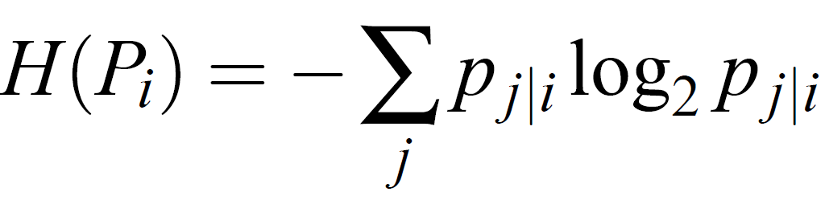
Perplexity is defined as:
Where H(.) is the Shannon entropy:

Slide 44
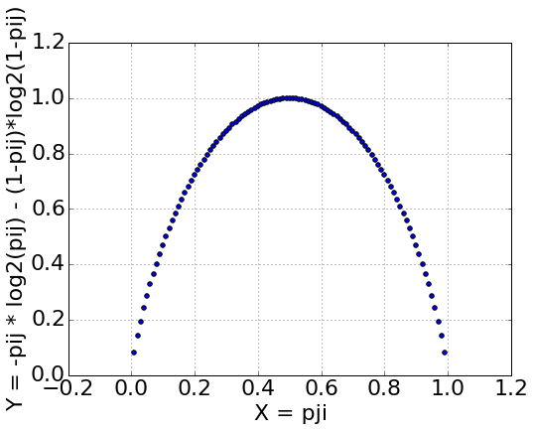
For a set value of sigma_i we can compute the probability distribution Pi for all other data points for xi
Entropy: high penalty if uncertain p(j|i) ~0.5

Slide 45
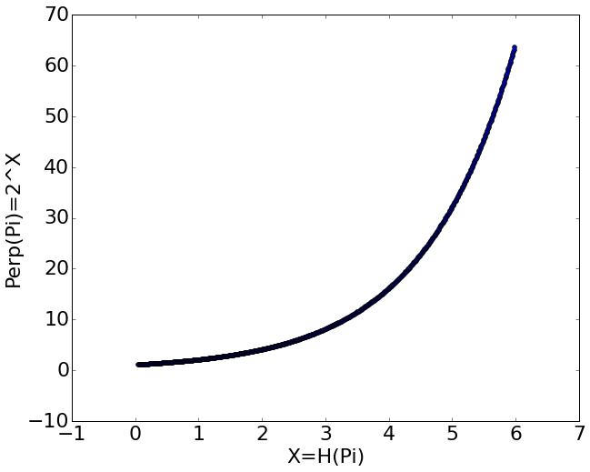
For a set value of sigma_i we can compute the probability distribution Pi for all other data points for xi
higher perplexity = less certain

Slide 46
Given variance, can compute Perplexity
Given a user specified Perplexity, find the variances that yield the Perplexity
(binary search)

Slide 47
Given variance, can compute Perplexity
Given a user specified Perplexity, find the variances that yield the Perplexity
(binary search)
Give a low perp

Slide 48
Given variance, can compute Perplexity
Given a user specified Perplexity, find the variances that yield the Perplexity
(binary search)
Encourages very high or low probabilities
Give a low perp

Slide 49
Given variance, can compute Perplexity
Which encourages smaller variances since more more probabilities will be given high or low values
(I think...)
Given a user specified Perplexity, find the variances that yield the Perplexity
(binary search)
Encourages very high or low probabilities
Give a low perp

Slide 50
Given variance, can compute Perplexity
Which encourages smaller variances since more more probabilities will be given high or low values
(I think...)
Given a user specified Perplexity, find the variances that yield the Perplexity
(binary search)
Encourages very high or low probabilities
Perp between 5 and 50 give different Entropy. Larger perps give very similar Entropy.
Give a low perp

Slide 51
Given a user specified Perplexity, find the variances that yield the Perplexity
(binary search)

Slide 52
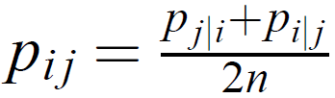
Prefer probabilities to be symmetric as gives simpler gradient that are faster to compute
[main reason]
Also claimed to help with outliers

Slide 53
Initialize a solution
(Randomly sample points in the low-d space near the origin)

Slide 54
Compute the probabilities that the points in the high-d space would choose each other as neighbors
Initialize a low-d solution
Phase 1 done

Slide 55
Gradient descent optimization
Phase 2

Slide 56
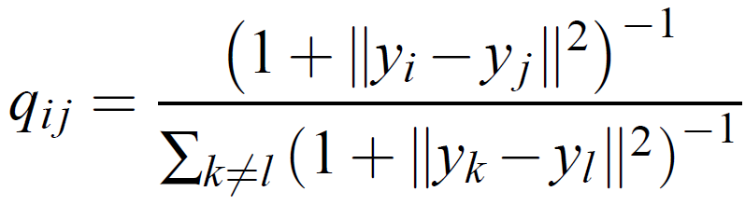
In the low-d space, probability that yi and yj choose each other as neighbors
Modeled as a Student t-distribution

Slide 57
In the low-d space, probability that yi and yj choose each other as neighbors
Modeled as a Student t-distribution

Slide 58
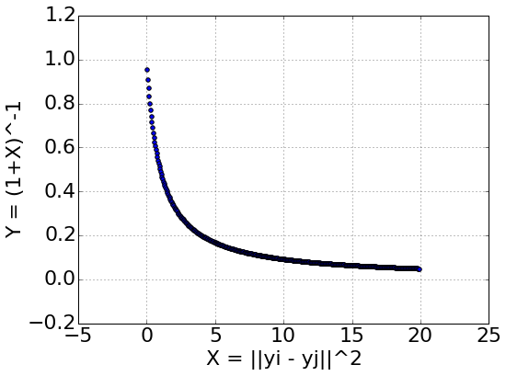
In the low-d space, probability that yi and yj choose each other as neighbors
Modeled as a Student t-distribution
Similar points (low distance) get a high probability

Slide 59
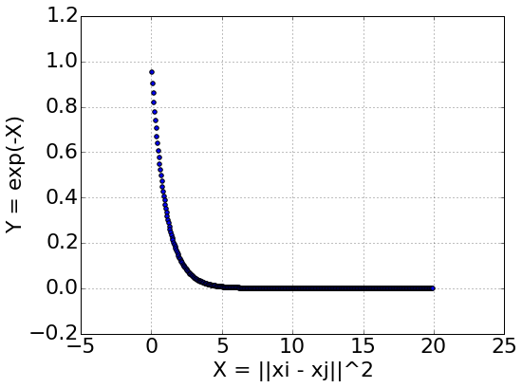
In the low-d space, probability that yi and yj choose each other as neighbors
Modeled as a Student t-distribution

Slide 60
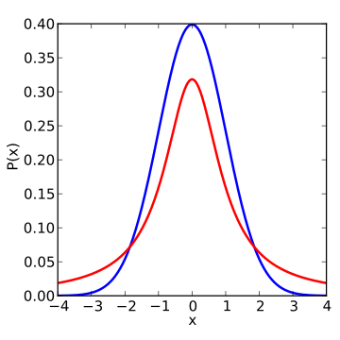
Student's has longer tails… gives higher probabilities to points that are further away
In the low-d space, probability that yi and yj choose each other as neighbors
Modeled as a Student t-distribution
Blue = Gaussian
Red = Student's T
http://en.wikipedia.org/wiki/Student%27s_t-distribution#/media/File:T_distribution_1df_enhanced.svg

Slide 61
Student's has longer tails… gives higher probabilities to points that are further away
In the low-d space, probability that yi and yj choose each other as neighbors
Modeled as a Student t-distribution
Blue = Gaussian
Red = Student's T
Desirable as, we have limited low-d space and want to focus on modelling the close high-d points.
Want to have moderately far high-d points further apart in the low-d space
(avoids crowding)
http://en.wikipedia.org/wiki/Student%27s_t-distribution#/media/File:T_distribution_1df_enhanced.svg

Slide 62
In the low-d space, probability Q that yi and yj choose each other as neighbors
Modeled as a Student t-distribution

Slide 63
In the low-d space, probability Q that yi and yj choose each other as neighbors
Modeled as a Student t-distribution
In the high-d space, probability P that xi and xj would choose each other as neighbor

Slide 64
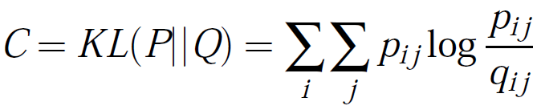
In the low-d space, probability Q that yi and yj choose each other as neighbors
Modeled as a Student t-distribution
In the high-d space, probability P that xi and xj would choose each other as neighbor
Minimize the Kullback-Leibler divergence between P and Q
if p = q then log(1) = 0
Penalize when p != q

Slide 65
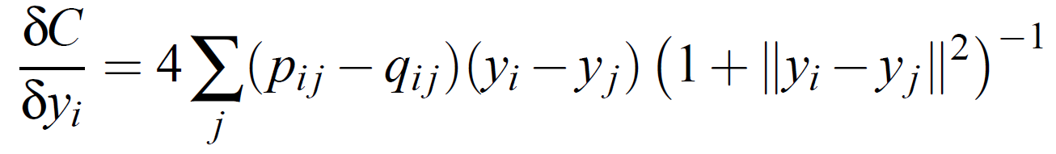
The derivative has a relatively simple form: (derivation in the paper)
Gradient of C with respect to yi

Slide 66
Gradient of C with respect to yi
Always a positive number (closer yi,yj get higher weight)

Slide 67
Gradient of C with respect to yi
Will be a positive or negative number
(discuss more later)
Always a positive number (closer yi,yj get higher weight)

Slide 68
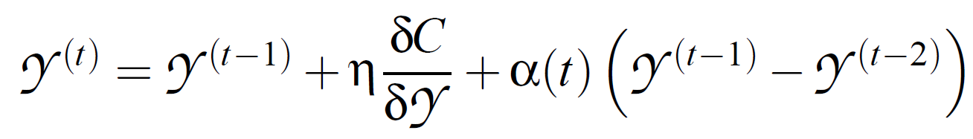
After we compute the gradient, update our solution …
The solution (i.e. low-d map) at time t

Slide 69
The weighted gradient
The solution (i.e. low-d map) at time t
The previous solution

Slide 70
The weighted gradient
The solution (i.e. low-d map) at time t
The previous solution
Weighted momentum of the previous solutions

Slide 71
solution at time t-1 and solution at t-2
0
1
2
3
4
y
t-1
t-2
= y^(t-1) - y^(t-2)
= 1 - 4 = -3
The weighted gradient
The solution (i.e. low-d map) at time t
The previous solution
Weighted momentum of the previous solutions

Slide 72
The weighted gradient
(should be negative…?)
The solution (i.e. low-d map) at time t
The previous solution
Weighted momentum of the previous solutions

Slide 73
Will always be positive, thus can ignore

Slide 74
Positive:
pij > qij and yi > yj
pij < qij and yi < yj
Negative:
pij < qij and yi > yj
pij > qij and yi < yj

Slide 75
Positive:
pij > qij and yi > yj
pij < qij and yi < yj
Negative:
pij < qij and yi > yj
pij > qij and yi < yj
pij = 0.8 → close in high-d
qij = 0.2 → far in low-d
0
1
2
3
4
yj
yi
Push yi further from yj???
Think we want to bring yi closer to yj, to increase qij

Slide 76
Positive:
pij > qij and yi > yj
pij < qij and yi < yj
Negative:
pij < qij and yi > yj
pij > qij and yi < yj
pij = 0.8 → close in high-d
qij = 0.2 → far in low-d
pij = 0.2 → far in high-d
qij = 0.8 → close in low-d
0
1
2
3
4
0
1
2
3
4
yj
yi
yj
yi
Push yi further from yj???
Push yi closer to yj???
Think we want to push yi further to yj, to decrease qij

Slide 77
Positive:
pij > qij and yi > yj
pij < qij and yi < yj
Negative:
pij < qij and yi > yj
pij > qij and yi < yj
pij = 0.8 → close in high-d
qij = 0.2 → far in low-d
pij = 0.2 → far in high-d
qij = 0.8 → close in low-d
0
1
2
3
4
0
1
2
3
4
yj
yi
yj
yi
Push yi further from yj???
Push yi closer to yj???
pij = 0.2 → far in high-d
qij = 0.8 → close in low-d
pij = 0.8 → close in high-d
qij = 0.2 → far in low-d
0
1
2
3
4
0
1
2
3
4
yi
yj
yi
yj
Thus, think we take the negative gradient
Push yi closer to yj???
Push yi further from yj???

Slide 78
To summarize ...

Slide 79
We have a data set of high-d data

Slide 80
In the high-d space, compute the probability P of points being neighbors

Slide 81
In the low-d space, compute the probability Q of points being neighbors

Slide 82
Move the low-d points around to minimize the difference between the two distributions

Slide 83
Minimize using gradient descent to find a local solution

Slide 84
Thus we find a low-d representation that captures the high-d data

Slide 85
Some important practical details ...

Slide 86
Not actually the raw data…
Use PCA to first reduce to the dimensions to 30
(method does not scale well to high-d)
Subset of the full dataset
(method does not scale well to high n)
Extensions of this work address this

Slide 87
Robust, but try different values

Slide 88
Good for visualization (2D or 3D). Not necessarily good for dimensionality reduction

Slide 89
Local optimum.
Different solution in each run.

Slide 90
tricks to improve optimization
(see paper)

Slide 91
"perfectly fine to run t-SNE ten times, and select the solution with the lowest KL divergence"
http://lvdmaaten.github.io/tsne/

Slide 92
the end

Slide 93
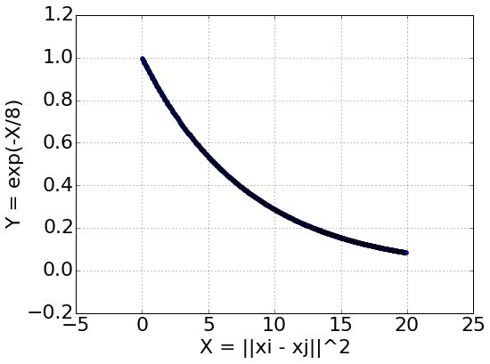
Probability that yi and yj would choose each other as neighbors
Modeled as a Student t-distribution
Changing the variance will give still more heavily penalize far distances in the low-d space

